Slide 1

Advanced NLP (Transformers – Bag 2)
NLP
Dr. Sajarwo Anggai, S.ST., M.T. NIDN : 0421108703

Slide 2
NLP Pipeline
Text Preprocessing
Feature Extraction
Modeling
Post-Processing
Deployment
Segmentation/ Tokenization
Normalization/ Lowercasing
Stopword Removal
Punctuation Removal
Stemming/ Lemmatization
Depedency parsing
Part-of-Speech Tagging
Bag of Words (BoW)
TF-IDF
Word Embeddings
Machine Learning
Deep Learning
Prediction
Evaluation
Fine-Tuning
Production
Monitoring and Updating

Slide 3
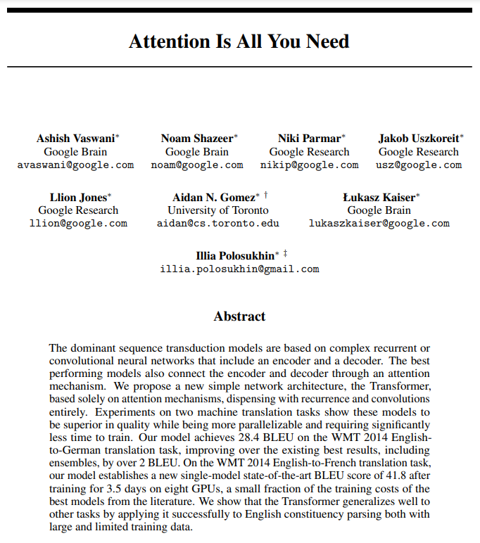
https://arxiv.org/pdf/1706.03762

Slide 4
Transformers
Apa Itu Transformers ?
Model transformers dalam deep learning adalah arsitektur jaringan saraf yang dirancang untuk menangani data berurutan dengan cara yang efisien dan paralel, terutama data dalam bentuk teks, yang berupa urutan token atau vector, melalui serangkaian lapisan yang berisi mekanisme self-attention dan jaringan saraf feedforward.
Refrensi : https://www.ibm.com/topics/transformer-model

Slide 5
Two big innovations
There are two primary innovations that transformer models bring to the table. Consider these two innovations within the context of predicting text.
Positional encoding: Instead of looking at each word in the order that it appears in a sentence, a unique number is assigned to each word.
Self-attention: Attention is a mechanism that calculates weights for every word in a sentence as they relate to every other word in the sentence, so the model can predict words which are likely to be used in sequence.
Refrensi : https://www.ibm.com/topics/transformer-model

Slide 6
Core Idea
Transformer models work by processing input data, which can be sequences of tokens or other structured data, through a series of layers that contain self-attention mechanisms and feedforward neural networks. The core idea behind how transformer models work can be broken down into several key steps.
Input Embedding
Positional Encoding
Multi-head Attention
Normalization & Residual Connection
Feedforward Neural Network
Stacked Layer
Output Layer
Training
Inference
Refrensi : https://www.ibm.com/topics/transformer-model

Slide 7
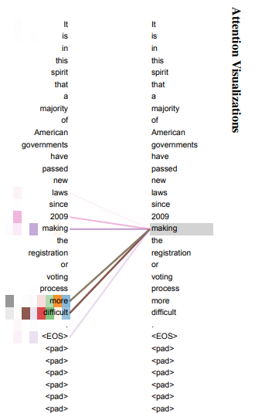
Core Idea
An example of the attention mechanism following long-distance dependencies in the encoder self-attention in layer 5 of 6. Many of the attention heads attend to a distant dependency of the verb ‘making’, completing the phrase ‘making...more difficult’. Attentions here shown only for the word ‘making’. Different colors represent different heads. Best viewed in color.
Refrensi : https://arxiv.org/pdf/1706.03762

Slide 8
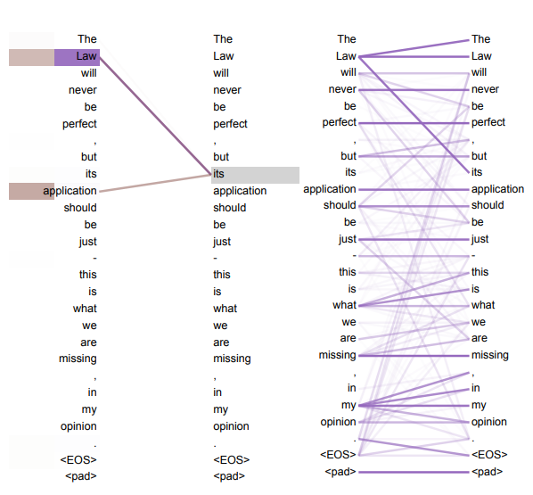

Slide 9
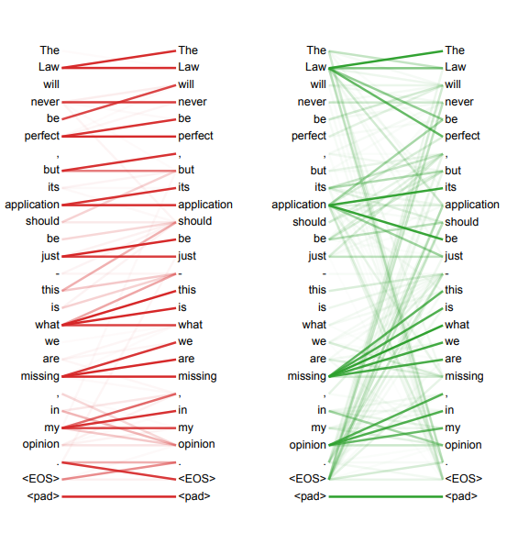

Slide 10
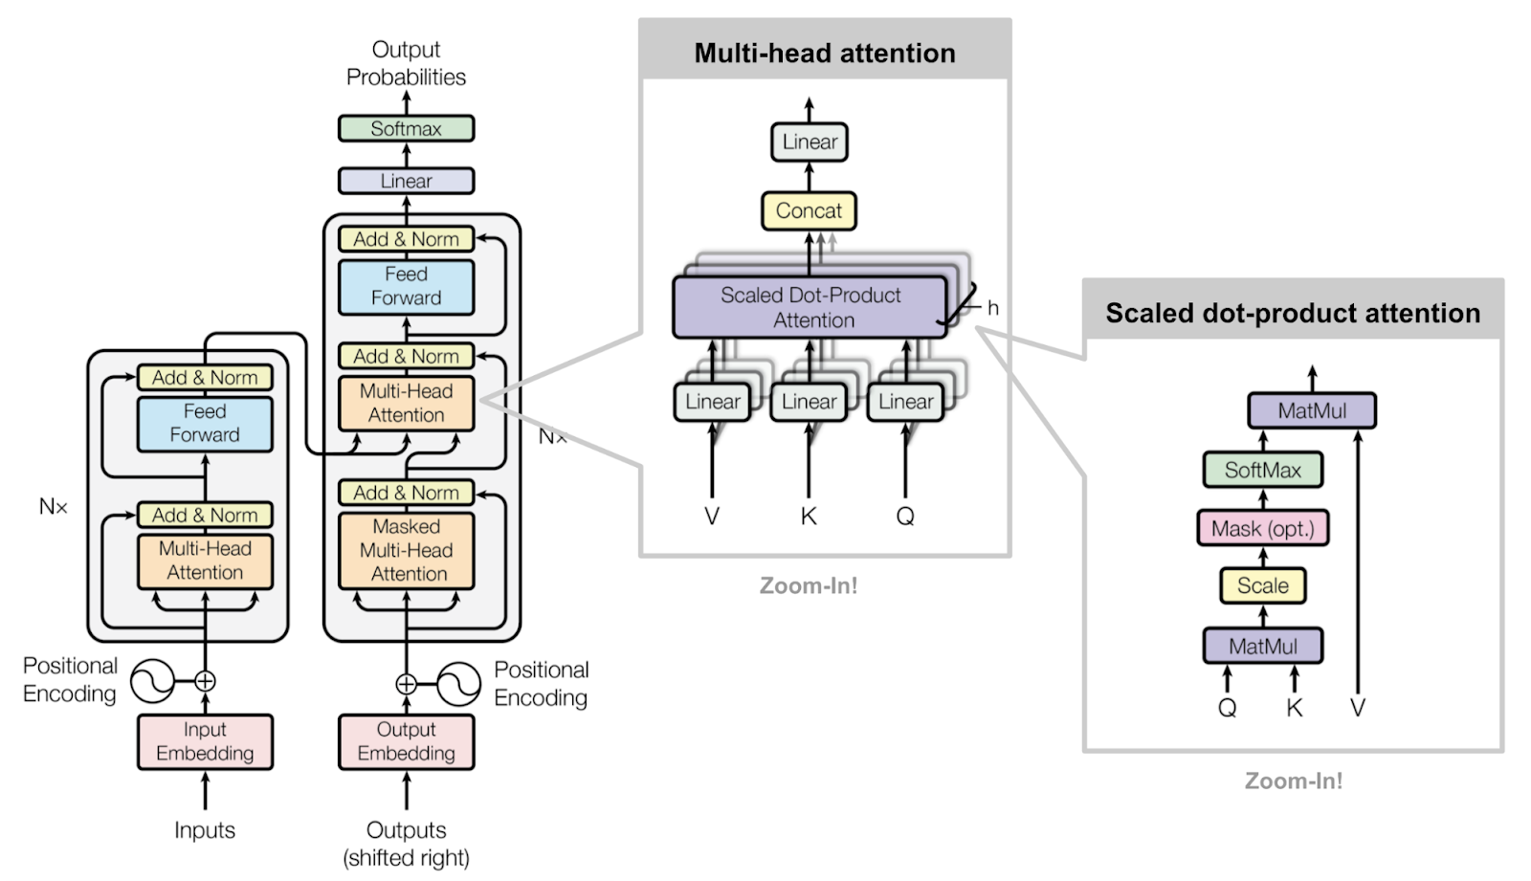
Komponen
Refrensi : https://neptune.ai/blog/bert-and-the-transformer-architecture/

Slide 11
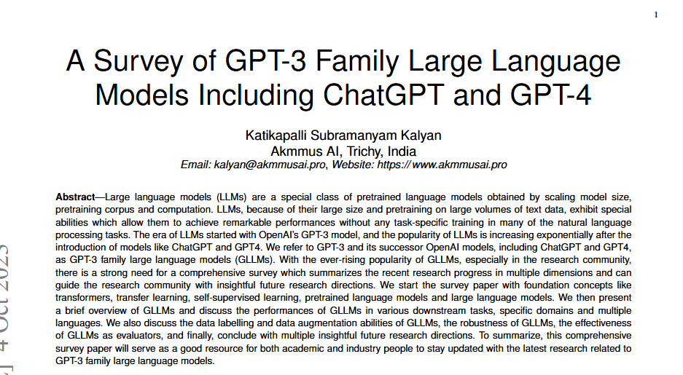
GPT
Refrensi : https://arxiv.org/pdf/2310.12321

Slide 12
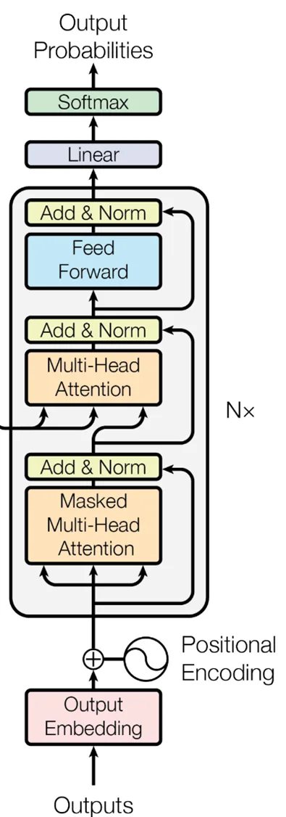
Komponen GPT : Decoder Only
Refrensi : https://www.edlitera.com/blog/posts/transformers-decoder-block

Slide 13
language models
A language model is a type of machine learning model trained to conduct a probability distribution over words. Put it simply, a model tries to predict the next most appropriate word to fill in a blank space in a sentence or phrase, based on the context of the given text.
For example, in a sentence that sounds like this, “Jenny dropped by the office for the keys so I gave them to [...],” a good model will determine that the missed word is likely to be a pronoun. Since the relevant piece of information here is Jenny, the most probable pronoun is she or her.
Refrensi : https://www.altexsoft.com/blog/language-models-gpt

Slide 14
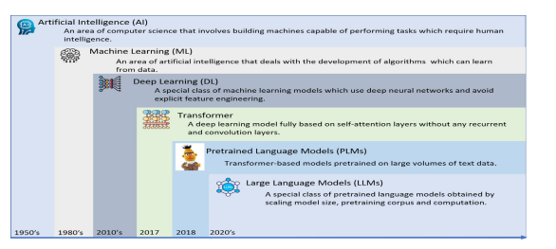
language models
Refrensi : https://doi.org/10.1016/j.nlp.2023.100048

Slide 15
Komponen GPT
Input Embedding
Positional Encoding
Dropout Layer
Transformer Blocks
Layer Stack
Final Layers
Refrensi : https://www.geeksforgeeks.org/introduction-to-generative-pre-trained-transformer-gpt/

Slide 16
BERT vs GPT
Feature | GPT (Generative Pre-trained Transformer) | BERT (Bidirectional Encoder Representations from Transformers)
Core Architecture | Autoregressive, generative | Bidirectional, context-based
Training Approach | Predicts the next word in a sequence | Uses masked language modeling to predict words from context
Direction of Context | Unidirectional (forward) | Bidirectional (both forward and backward)
Primary Usage | Text generation | Text analysis and understanding
Generative Capabilities | Yes, designed to generate coherent text | No, focuses on understanding text not generating
Pre-training | Trained on large text corpora | Trained on large text corpora with masked words
Fine-tuning | Necessary for specific tasks | Necessary, but effective with fewer training examples
Output | Generates new text sequences | Provides contextual embeddings for various NLP tasks
Refrensi : https://www.geeksforgeeks.org/differences-between-gpt-and-bert/

Slide 17
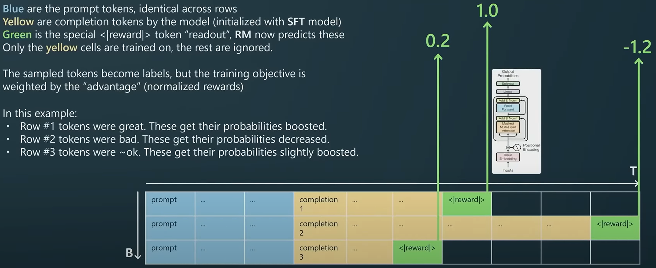
State – of - GPT
Refrensi : https://www.youtube.com/watch?v=bZQun8Y4L2A

Slide 18
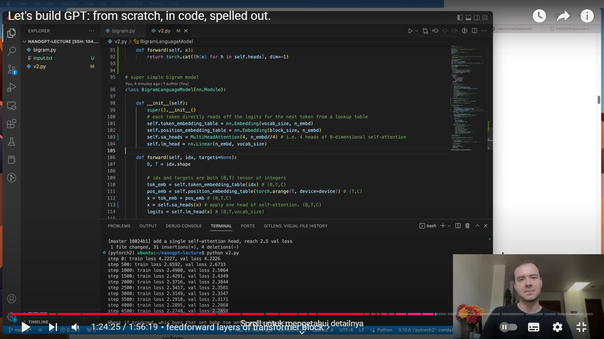
GPT from Scratch
Refrensi : https://www.youtube.com/watch?v=kCc8FmEb1nY

Slide 19
Percobaan GPT untuk Chatbot Sederhana 1. Import Library dan data yang akan digunakan (menggunakan torch sebagai library)
from transformers import GPT2LMHeadModel, GPT2Tokenizer
import torch

Slide 20
2. Mendownload Model & Tokenizer
# Model GPT yang digunakan
model_name = 'gpt2'
model = GPT2LMHeadModel.from_pretrained(model_name)
tokenizer = GPT2Tokenizer.from_pretrained(model_name)
model.eval()
Notes:
https://huggingface.co/transformers/v3.0.2/_modules/transformers/configuration_bert.html#BertConfig

Slide 21
3. Parameter Chatbot
class CustomGPT(nn.Module):
def __init__(self,
vocab_size=40478,
n_positions=512,
n_embd=768,
n_layer=12,
n_head=12,
afn="gelu",
resid_pdrop=0.1,
embd_pdrop=0.1,
attn_pdrop=0.1,
layer_norm_epsilon=1e-5,
initializer_range=0.02,
summary_type="cls_index",
summary_use_proj=True,
summary_activation=None,
summary_proj_to_labels=True,
summary_first_dropout=0.1,
**kwargs):
super().__init__()
Notes:
https://huggingface.co/transformers/v3.0.2/model_doc/bert.html

Slide 22
Penjelasan Parameter
vocab_size (default: 40478) : Ukuran dari vocabulary yang digunakan oleh model.
n_positions (default: 512) : Jumlah posisi yang akan diproses oleh model untuk setiap input.
n_embd (default: 768) : Dimensi embedding (representasi vektor) untuk token.
n_layer (default: 12) : Jumlah layer transformer dalam model.
n_head (default: 12) :J umlah "heads" dalam mekanisme perhatian (attention) multi-head
afn (default: "gelu") : Fungsi aktivasi yang digunakan setelah layer transformer.
resid_pdrop (default: 0.1) : Dropout yang diterapkan pada residual connections untuk mengurangi overfitting.
embd_pdrop (default: 0.1): Dropout yang diterapkan pada embedding layer untuk regularisasi.
attn_pdrop (default: 0.1) : Dropout yang diterapkan pada mekanisme perhatian (attention) untuk regularisasi.
layer_norm_epsilon (default: 1e-5) : Nilai epsilon yang digunakan dalam normalisasi layer untuk stabilitas numerik.
initializer_range (default: 0.02) : Rentang inisialisasi bobot model.
summary_type (default: "cls_index") : Jenis ringkasan yang digunakan dalam tugas pemodelan.
summary_use_proj (default: True) : Menentukan apakah ringkasan menggunakan proyeksi (biasanya berupa layer linear) atau tidak.
summary_activation (default: None) : Fungsi aktivasi yang digunakan pada layer proyeksi ringkasan.
summary_proj_to_labels (default: True) : Menentukan apakah proyeksi ringkasan akan diproyeksikan ke label (output) model.
summary_first_dropout (default: 0.1) : Dropout yang diterapkan pada layer pertama dari proyeksi ringkasan.

Slide 23
3. Fungsi Chatbot
def chatbot_response(input_text):
input_ids = tokenizer.encode(input_text, return_tensors='pt')
output = model.generate(
input_ids,
max_length=150, # Panjang maksimal respons
temperature=0.7, # Tingkat kreativitas respons
top_k=50, # Banyaknya pilihan token teratas
top_p=0.95, # Probabilitas kumulatif untuk sampling
repetition_penalty=1.2, # Menghindari pengulangan kata
num_return_sequences=1 # Hanya menghasilkan satu respons
)
response = tokenizer.decode(output[0], skip_special_tokens=True)
return response
Notes:
https://huggingface.co/transformers/v3.0.2/model_doc/bert.html

Slide 24
4. Contoh Penggunaan
print("Chatbot siap untuk percakapan! Ketik 'quit' untuk keluar.")
while True:
user_input = input("You: ") # Pengguna memasukkan input
if user_input.lower() == 'quit':
print("Chatbot: Sampai jumpa!")
break
response = chatbot_response(user_input)
print(f"Chatbot: {response}")
Notes:
https://huggingface.co/transformers/v3.0.2/model_doc/bert.html

Slide 25
5. Fine-Tuning (Optional)
from transformers import Trainer, TrainingArguments
# Tentukan argumen pelatihan
training_args = TrainingArguments(
output_dir='./results', # Direktori tempat hasil pelatihan disimpan
num_train_epochs=3, # Jumlah epoch
per_device_train_batch_size=4, # Ukuran batch
per_device_eval_batch_size=8, # Ukuran batch untuk evaluasi
logging_dir='./logs', # Direktori untuk log
)
trainer = Trainer(
model=model, # Model yang dilatih
args=training_args, # Argumen pelatihan
train_dataset=train_dataset, # Dataset pelatihan
eval_dataset=eval_dataset # Dataset evaluasi
)
# Mulai pelatihan
trainer.train()

Slide 26
Ref Tambahan
https://www.analyticsvidhya.com/blog/2021/05/hands-on-experience-with-gpt3/
https://towardsdatascience.com/openai-gpt-2-understanding-language-generation-through-visualization-8252f683b2f8
https://www.geeksforgeeks.org/open-ai-gpt-3/
https://www.geeksforgeeks.org/introduction-to-generative-pre-trained-transformer-gpt/
https://www.geeksforgeeks.org/differences-between-gpt-and-bert/
https://www.geeksforgeeks.org/getting-started-with-chatgpt-a-complete-guide-with-examples/
https://www.geeksforgeeks.org/the-evolution-of-language-models-from-gpt-1-to-gpt-4-and-beyond/
https://huggingface.co/docs/transformers/model_doc/openai-gpt

Slide 27
Tugas
Cari 10 jurnal terkait dengan Transformers
Buatlah program untuk menampilkan hasil dari percobaan Transformers

Slide 28

Universitas Pamulang
Prodi Teknik Informatika S-2
Sajarwo Anggai
Dosen – Universitas Pamulang
NIDN : 0421108703
Email : dosen02832@unpam.ac.id
Terima Kasih

